Slide 1
Cloud Based People Counter
By : The Tech Geeks

Slide 2
Idea
To create a Cloud Based People Counter using MATLAB.
The project uses a Webcam,Computer Vision to detect faces and count the number of people.

Slide 3
Skills & expertise
Webcam
Computer Vision & Image Processing
MATLAB
Thingspeak
IoT

Slide 4
This project reduces the effort of counting people manually in a seminars , trade shows , institutes , etc.
Real World Solution

Slide 5

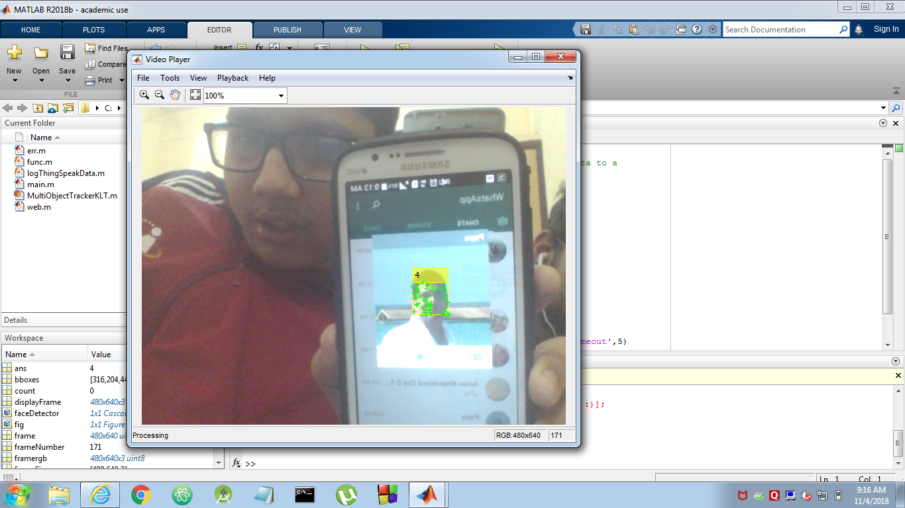
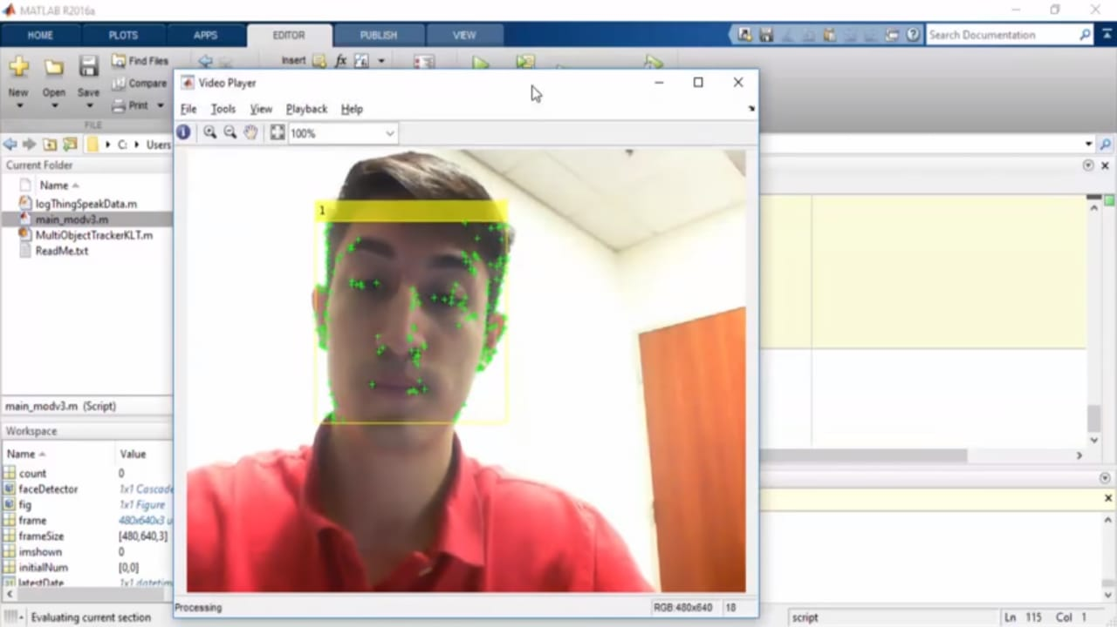
One of our team member - Devashish Purohit

Slide 6
Approach
The code is written in MATLAB.The program facilitates human face detection through a webcam and the data obtained (count of people) is stored over internet via “ThingSpeak” which is linked via unique Channel ID and API Read Key and API Write Key.

Slide 7
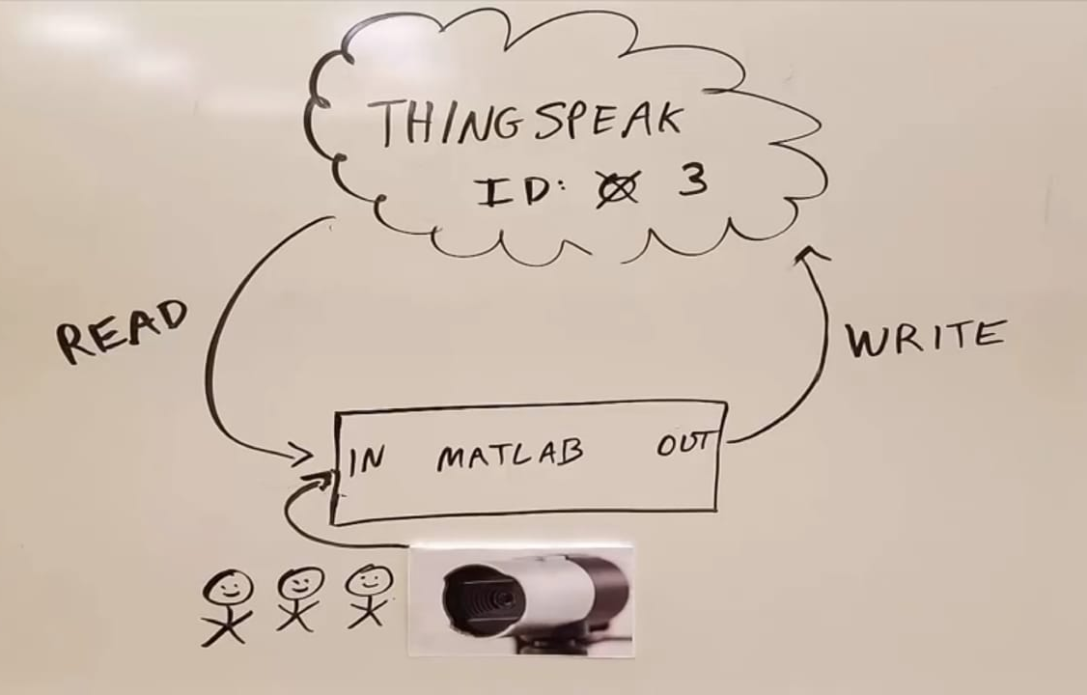
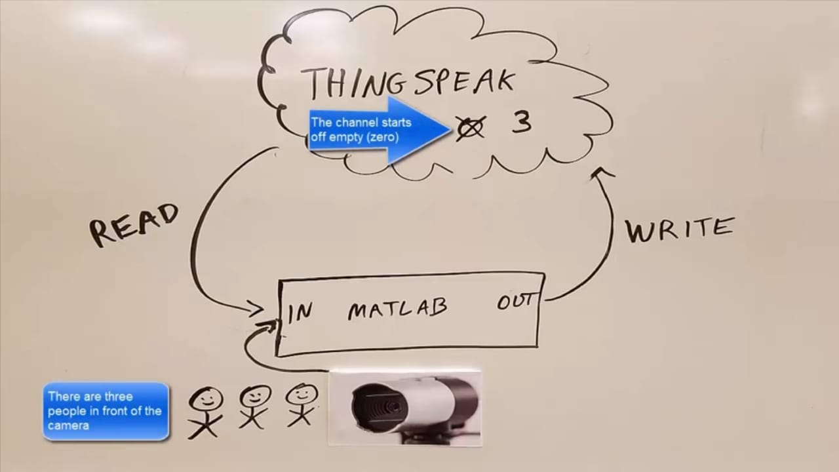

Slide 8
Future Directions
Gender Detection
Age Detection
Emotion Detection
Face Biometric

Slide 9
Features:
Detects the face even if the face is rotated
Displays the Frame and the Tracking Points that are used to detect the face
Tracks multiple faces at the same time
Can Tracks images of a person

